Slide 1


Carbox
Your car, anywhere, everywhere.
Francisco Albergaria, 114646, LEI (Product Owner)
Gabriel Santos, 113682, LEI (DevOps)
Guilherme Amaral, 113207, LEI (Team Manager)
João Gaspar, 114514, LEI (Architect)
Guided by:
Teacher João Almeida
Teacher Daniel Ferreira
INTRODUCTION TO SOFTWARE ENGINNERING

Slide 2
Index
Product Concept
Architecture
Live Demo
Team Planning
User Stories
Future Iterations
Conclusion

Slide 3
Product Concept
Carbox is web application which focuses on providing each of its users with precise and up to date information about their vehicles, presenting it in a simple, efficient and concise way.
Such data is retrieved from each vehicle sensors through the use of an installed (or connected) ECU (Electronics Control Unit), that allows us to connect the vehicle to our system.
Our target users range from:
Any regular person that (legally, we hope) uses a car
Professional Racing Technicians
Mechanics
Car Shop Owners

Slide 4
Live Demonstration
^Click Me^

Slide 5
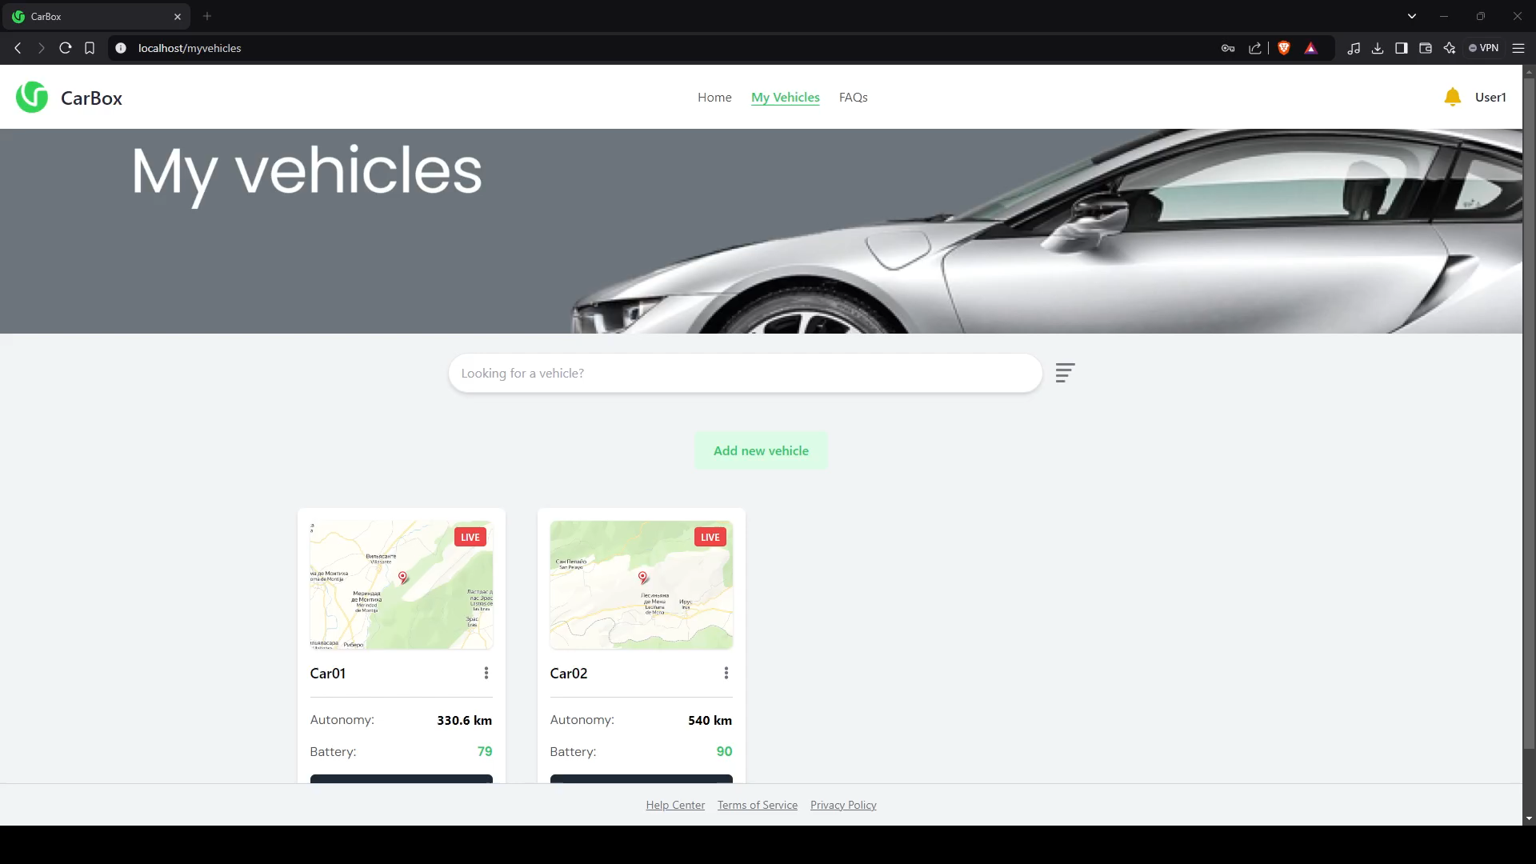
User Stories
As a mechanic, António wants to access detailed diagnostics of customer vehicles, so he can quickly identify issues and carry out repairs efficiently.
The system provides a clear dashboard showing all vehicle diagnostics in real-time.
The diagnostics include detailed information such as engine status, battery level, and error codes.
The system allows the link of several vehicles to the same customer.

Slide 6
User Stories
As a race driving technician, Sofia wants to receive real-time data on the car's technical performance during races, so she can adjust and ensure the car is running at its optimal level.
The system provides real-time telemetry data during trips (e.g., engine temperature, tire pressure, speed, etc).
Alerts are triggered when critical performance thresholds are exceeded (e.g., overheating).
The user can view past trips data for comparison and optimization.

Slide 7
User Stories
As a photographer, Inês wants to get a prediction of how long her car can run with the current fuel level, so she can plan her trips as a freelancer.
The system calculates an estimate of the remaining driving range based on current fuel levels and recent driving habits.
Notifications are triggered when the fuel level is critically low.

Slide 8
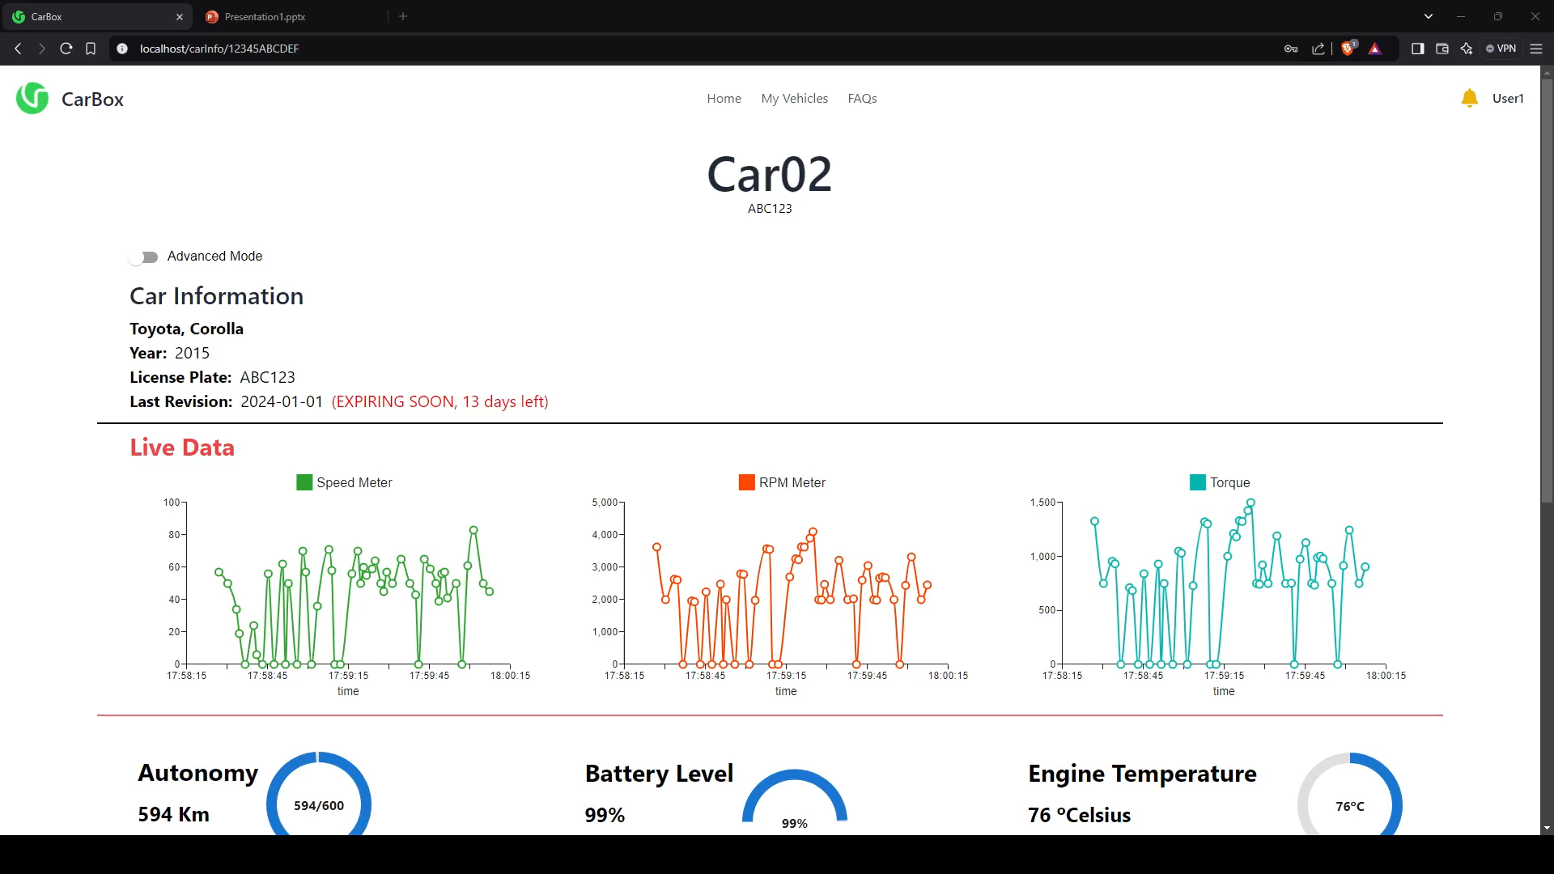
User Stories
As a test drive supervisor, Hugo wants to check the last test drive routes and performance data for cars, to ensure that the vehicles are in good condition before showing them to potential buyers.
The system logs all trip routes with timestamps.
Performance data (e.g., speed, fuel consumption, engine performance) is available for each trip.
Alerts are generated if any performance anomalies are detected during drives.
8

Slide 9
User Stories
As a dealership manager, Mateus wants to monitor the condition of cars in his dealership, so he can ensure they are maintained properly and ready for sale or test drives.
The system shows the maintenance status of all vehicles associated with the client.
It alerts the user when any vehicle requires servicing or inspection.
Vehicle history, including past services and test drives, is available in the system.

Slide 10
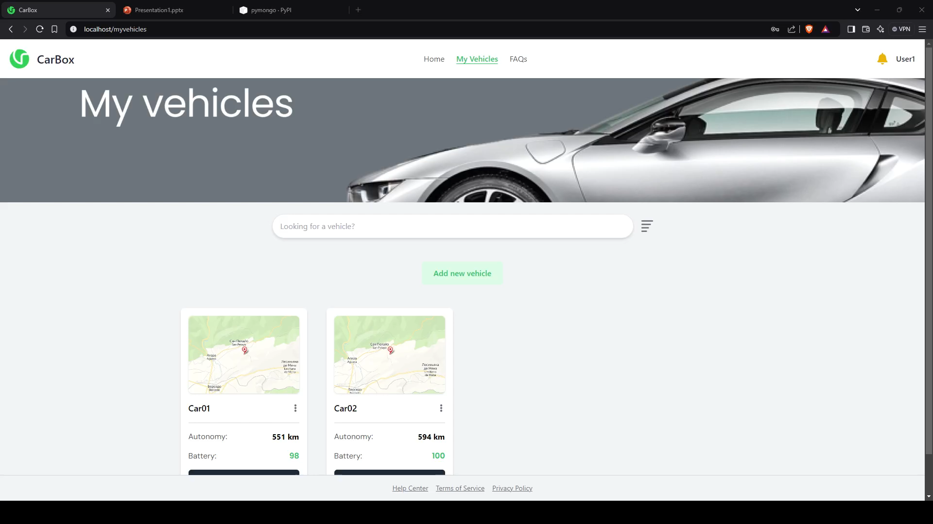
User Stories
As a teacher, Albano wants to check the last known location of his car, so he can remember where he parked it.
The system shows the last recorded location of the car on a map.
The location data includes a timestamp of when the car was last parked.

Slide 11
User Stories
As a teacher, Albano wants to check the last known location of his car, so he can remember where he parked it.
The system shows the last recorded location of the car on a map.
The location data includes a timestamp of when the car was last parked.

Slide 12
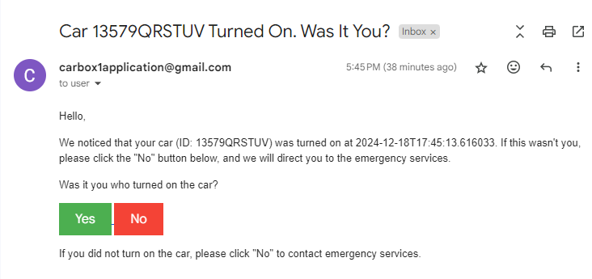
User Stories
As a lawyer, Maria wants to receive a notification whenever her car is moved, to ensure it hasn’t been stolen.
The system sends an instant notification to the phone when the car is turned on.
The notification includes the time and current location of the vehicle.
A confirmation request is sent to the user to verify whether the movement was authorized, if unauthorized, the system provides an option to alert local authorities.

Slide 13
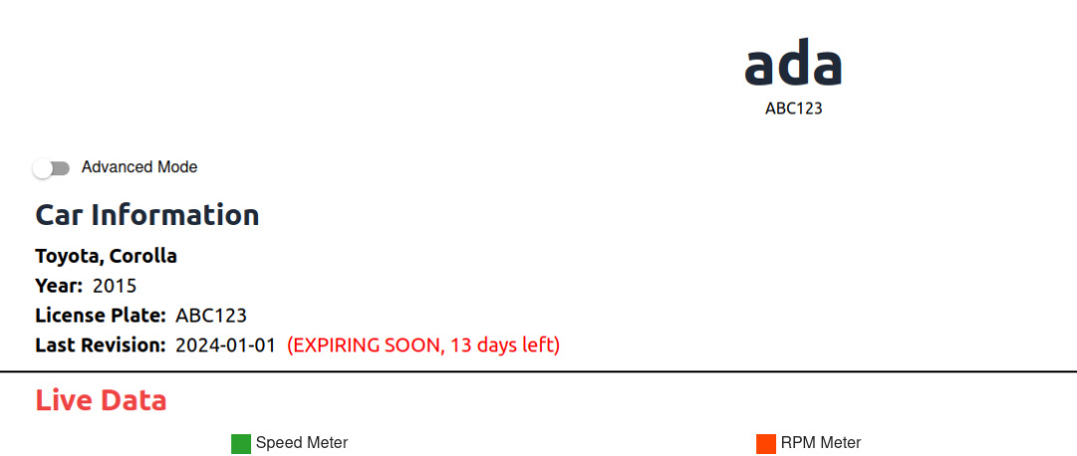
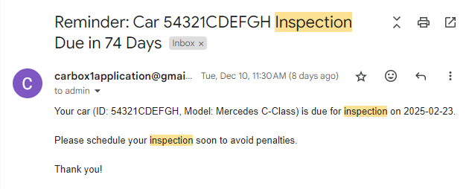
User Stories
As a journalist, Marta wants to be notified when her car’s mandatory inspection is approaching, to avoid fines and legal issues.
The system sends reminders 30 days, 7 days, and 1 day before the mandatory inspection date.
A countdown to the inspection date is displayed on the dashboard.
Notifications include required documents and checks for the inspection

Slide 14
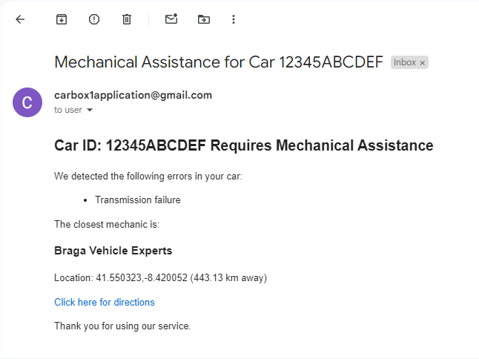
User Stories
As a musician, Francisco wants to get the location of close mechanics along with his alerts so that he knows where to take his car to fix the issue.
The system gives a list of close mechanics or shops along with the alert every time the car has a big problem
The list has the GPS location associated with each shop

Slide 15
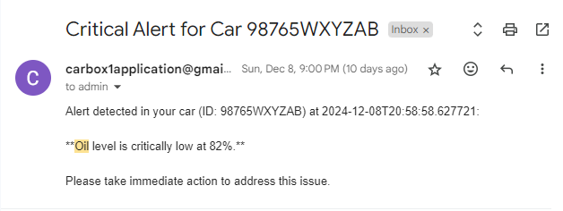
User Stories
As a programmer, Diogo wants to receive alerts for oil level, so he can avoid issues and plan maintenance in advance.
Notifications are sent when the oil level falls below the set threshold.
Historical data on oil level is available for monitoring trends.

Slide 16
User Stories
As a car enthusiast, Luís wants to track all the custom modifications made to his car, so he can optimize it for future tuning and events.
The system allows to log modifications made to the vehicle.
A summary report of all custom modifications is available.

Slide 17
User Stories
As a taxi driver, Ricardo wants to access his car’s average monthly fuel consumption, so he can better manage his expenses and earnings.
The system calculates and displays the average monthly fuel consumption in litres/gallons and cost.
Historical fuel consumption data is available for up to 12 months.

Slide 18
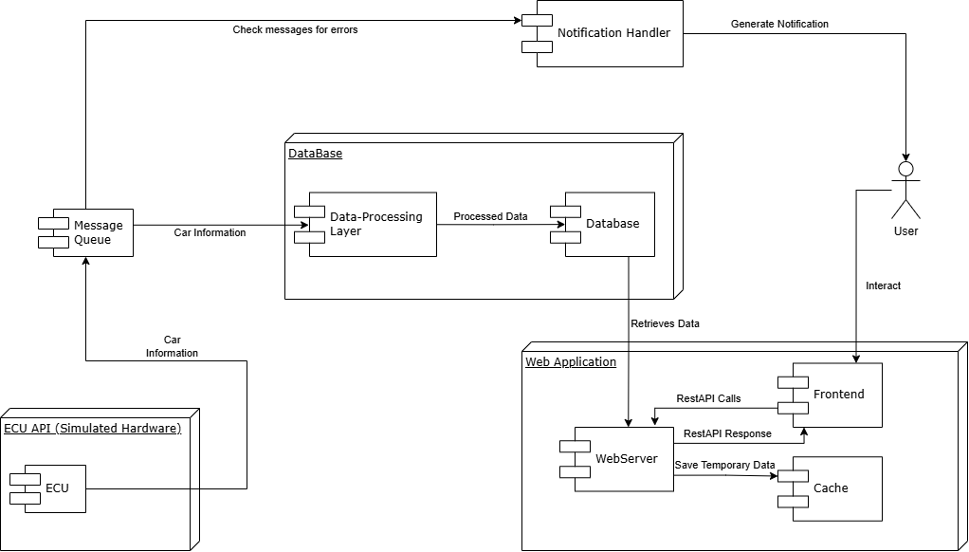
Current Product Architecture

Slide 19
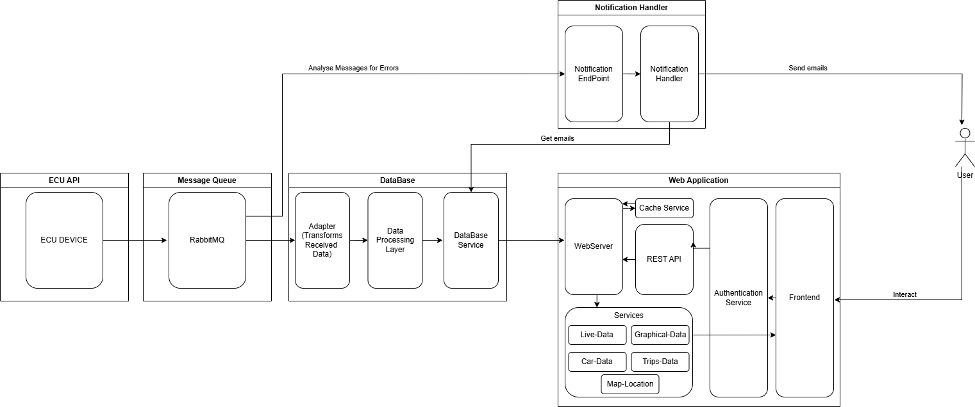
Current Product Architecture

Slide 20
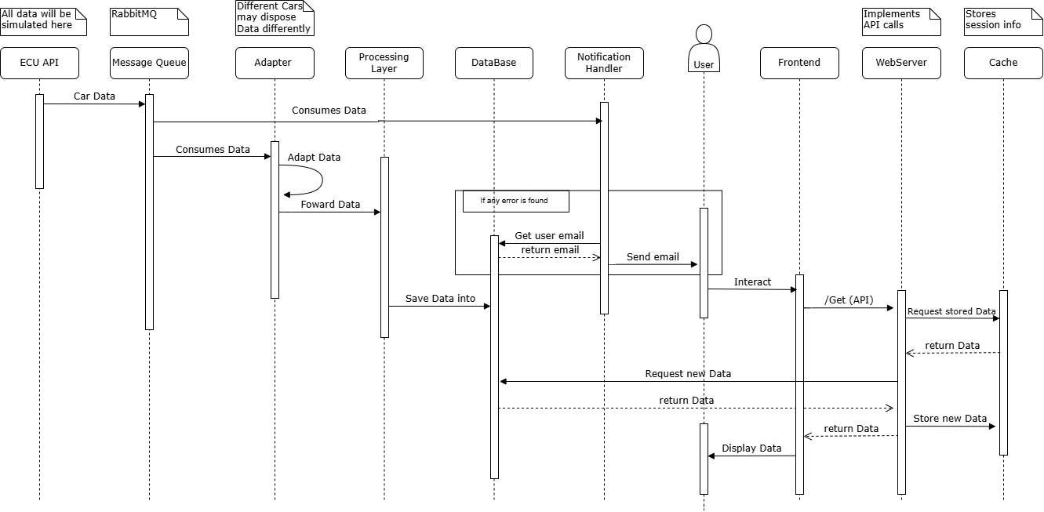
Current Product Architecture
Sequential Diagram

Slide 21
Team Planning
One of the main objectives in this course was for us to understand and learn the whole process of developing a software and working as a team. Therefore, the following details were of the most importance:
Pull Requests and Issues Templates
Weekly Meetings (Average of 3 meetings per Iteration)
Minutes for each meeting
Use of an Iteration based Github workflow and backlog.

Slide 22
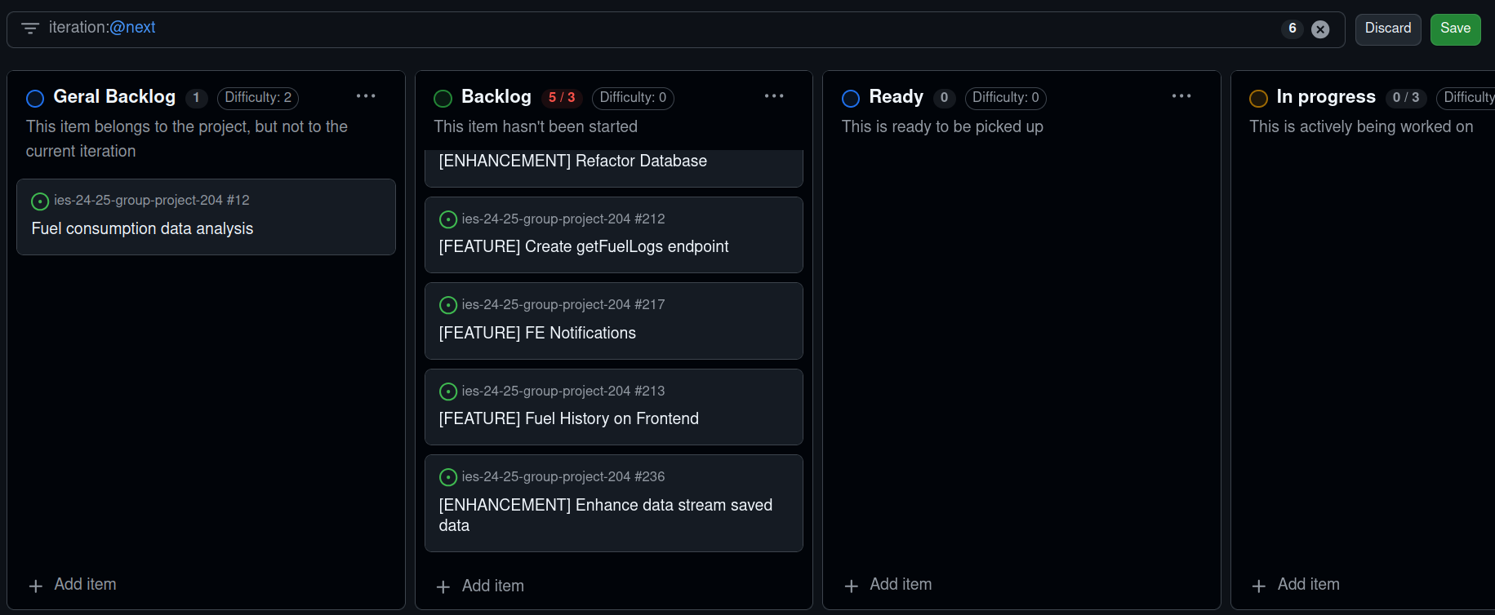
Future Iterations
Implement Missing User Story
Implement Frontend Push Notifications
Enhance Data Processing

Slide 23
Conclusion
Most defined goals were successfully reached
Learned good practices in Software Development
Improved our collaboration skills
Learned different technologies
Learned importance of each role and how to impersonate them
Sharpen planning/visioning skills

